Slide 1

Toxicology
Kevin Carey and Kristen Chila
May 2015

Slide 2

Question:
What are the effects of soy on the body?

Slide 3
What is Soy and Where Can you Find It?
The soybean is a legume and is considered to be a complete protein as it has an amino acid profile close to that of animal products. It can be found in:
Soy Sauce (Tamari, Shoyu, Teriyaki)
Edamame
Miso
Tempeh
Textured Soy Protein (TSP)
Low-fat peanut butter
Processed meats
Sauces
Baked goods
Canned tuna and meat
Cereals,
Cookies
Crackers
High-protein energy bars and Snacks
Infant formulas
Soy Milk
Tofu
Soy Nuts
Whole Soybeans
Soy Protein
Canned broths and soups

Slide 4
History
Traditionally soy grown as a cover crop, to be ground back into the soil to increase nitrogen content.
Currently, soy beans are the dominant oil seed in the US (90% oil seed production), introduced after the industrial revolution (USDA, 2012).
Leftover proteins were introduced into the US food supply.
Soy was marketed as a health food beginning in the 1930’s.
Traditionally only fermented soy products were eaten (for the reduced phytic acid concentration – to be discussed later).

Slide 5
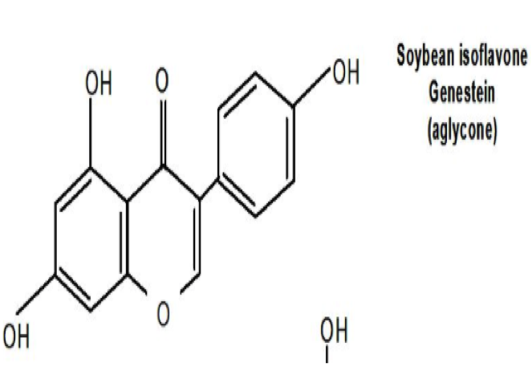
Phytoestrogens
Phytoestrogens are naturally occurring in certain plants, the main compound being isoflavones.
Isoflavone: polyphenolic compounds that can exert estrogen-like effects
Primary isoflavone in soy: Genistein

Slide 6
Mechanism of action of Genistein
Genistein exhibits estrogenic effects, the mechanism of action is not fully understood
(Nynca et al., 2013).
Genistein inhibits tyrosine kinase by allosterically inhibiting the epidermal growth factor (EGF) receptor site. This effects cell proliferation and differentiation, inducing apoptosis (Anupongsanugool et al., 2005).
TGF beta 1 is involved with the control of cell growth, cell differentiation, apoptosis, and cellular homeostasis similar to the effects seen with Genistein (Kim et al., 1998).

Slide 7
Dose Response for Toxic Action and Injury
Studies have shown that soy based infant formulas have resulted in phytoestrogen plasma concentration levels 13,000-20,000x higher than endogenous concentrations in infants (CDC, 2013).
In rats: (Delclos et al., 2007)
At 1250 ppm, abnormal ovarian follicles and aberrant or delayed spermatogenesis, significantly decreased body weight (females 12%, males 9% - ventral prostate 28%) were observed.
At 650 ppm, a deficit in sperm count in the epididymis was observed.
At 250 ppm, females showed increased renal tubule mineralization, female pups shows ductal/alveolar hyperplasia of the mammary glands.

Slide 8
Metabolism of Isoflavones
Ingested in beta-glucosidic form
Converted into aglucone forms via hydrolyzation in the intestines
Absorbed and glucuronated in intestinal wall and liver
Excreted in urine and feces as glucaronides and
sulphates
Elimination half life: 7.61 +/- 2.44 hours (Anupongsanugool et al., 2005).

Slide 9
Risk of Exposure
91% of soy crops are genetically engineered to resist toxic levels of Round-Up (Samsel & Seneff, 2013).
Genetic engineering of soybeans began as early as 1998 (Samsel & Seneff, 2013).
US is currently the largest producer of soy in the world, 77.5 million acres (2009), mostly upper Midwest US, crop rotated with corn
Soy is considered one of the top allergens in North America
Additives: found in 60%+ of processed foods
Cephalin/LPE: a fruit ripener and shelf-life extender (food and cut flowers). (The Weston A. Price Foundation, 2015)
Lecithin is a common emulsifier:
“… lecithin comes from sludge left after crude soy oil goes through a “degumming” process. It is a waste product containing solvents and pesticides and has a consistency ranging from a gummy fluid to a
plastic solid.”
- Soy lecithin: From Sludge to Profit, Weston A. Price (2010)

Slide 10
Phytic Acid/Phytate
Phytic acid is a natural insect repellant found on the outside of grains and legumes. In the human body it is considered an anti-nutrient, blocking mineral absorption, particularly iron, calcium, zinc, magnesium, manganese (Bohn et al., 2008).
Can be reduced by removing the bran layer (Bohn et al., 2008)or soaking grains and legumes for 8-12 hours prior to cooking (Weston A. Price, 2010).
Cannot be significantly reduced in soy by soaking, but can be reduced by fermentation
(Amadou et al., 2009).

Slide 11
Safer Alternatives to Soy
Choose non-GMO, fermented or sprouted soy products.
Pair soy with seaweed products to counterbalance effects of iodine deficiency on thyroid depression (Colbin, 1986).
Alternative vegetarian protein sources: nuts, nut milks, rice milk, legumes, grains.

Slide 12
Benefits
Pure Genistein inhibits osteoclast function, could be
beneficial to females during menopause or post- ovarectomy, when endogenous estrogen is low (Kim et al., 1998).
Attenuation of hereditary hemorrhagic telangiectasia (HHT) (via inhibition of angiogenesis).
Case study: after 2 weeks of soy beverages
twice daily, 60% of participants had complete
remission of symptoms. (Kim et al., 1998).

Slide 13
Sources:
Amadou, S., Yong-Hui, J., Guo-Wei, S., & Guo-Wei, L. (2009). Fermented Soybean Products: Some Methods, Antioxidants Compound Extraction and their Scavenging Activity. Asian Journal of Biochemistry, 4, 68-76.
Anupongsanugool, E., Teekachunhatean, S., Rojanasthien, N., Pongsatha, S., & Sangdee, C. (2005). Pharmacokinetics of isoflavones, daidzein and genistein, after ingestion of soy beverage compared with soy extract capsules in postmenopausal Thai women. BMC Clinical Pharmacology, 5, 2. doi:10.1186/1472-6904-5-2
Bohn, L., Meyer, A.S., & Rasmussen, S.K. (2008). Phytate: impact on environment and human nutrition. A challenge for molecular breeding. Journal of Zhejiang University Science B. 9(3), 165–191. doi: 10.1631/jzus.B0710640
Colbin, A. (1986). Food and Healing. New York, NY: Ballantine Books, Random House Publishing Group.
Delclos, K.B., & Newbold, R. (2007). NTP toxicity report of reproductive dose range-finding study of Genistein (CAS No. 446-72-0) administered in feed to Sprague-Dawley rats. National Toxicology Program - Toxicity Report Series, 1-79.
Kim, H., Peterson, T.G., & Barnes, S. (1998). Mechanisms of action of the soy isoflavone genistein: emerging role for its effects via transforming growth factor beta signaling pathways. American Journal of Clinical Nutrition, 68(6), 1418-1425.
Nynca, A., Nynca, J., Wąsowska, B., Kolesarova, A., Kołomycka, A., & Ciereszko, R.E. (2013). Effects of the phytoestrogen, genistein, and protein tyrosine kinase inhibitor–dependent mechanisms on steroidogenesis and estrogen receptor expression in porcine granulosa cells of medium follicles. Domestic Animal Endocrinology, 44(1), 10-18. doi: http://dx.doi.org/10.1016/j.domaniend.2012.07.002

Slide 14
Sources:
Samsel, A., & Seneff, S. (2013). Glyphosate’s Suppression of Cytochrome P450 Enzymes and Amino Acid Biosynthesis by the Gut Microbiome: Pathways to Modern Diseases. Entropy, 15, 1416-1463.
The Weston A. Price Foundation. (2010). Living with Phytic Acid. Retrieved from http://www.westonaprice.org/health-topics/living-with-phytic-acid/
The Weston A. Price Foundation. (2015). Soy Lecithin: From Sludge to Profit. Retrieved from http://www.westonaprice.org/health-topics/soy-lecithin-from-sludge-to-profit/
United States Centers for Disease Control and Prevention. (2013). Phytoestrogens. Retrieved from http://www.cdc.gov/biomonitoring/Phytoestrogens_BiomonitoringSummary.html
United States Department of Agriculture - Economic Research Service. (2012). Soybeans & Oil Crops. Retrieved from http://www.ers.usda.gov/topics/crops/soybeans-oil-crops/background.aspx

